Slide 1


Unit 2: Lesson 7 Mother nature and its wild side

Slide 2
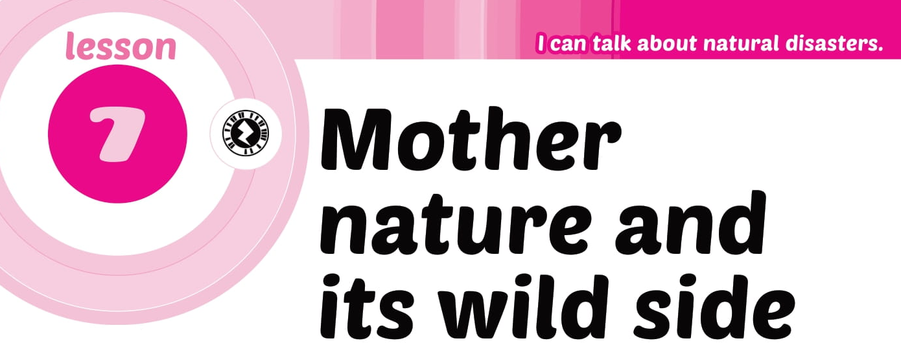

Slide 3
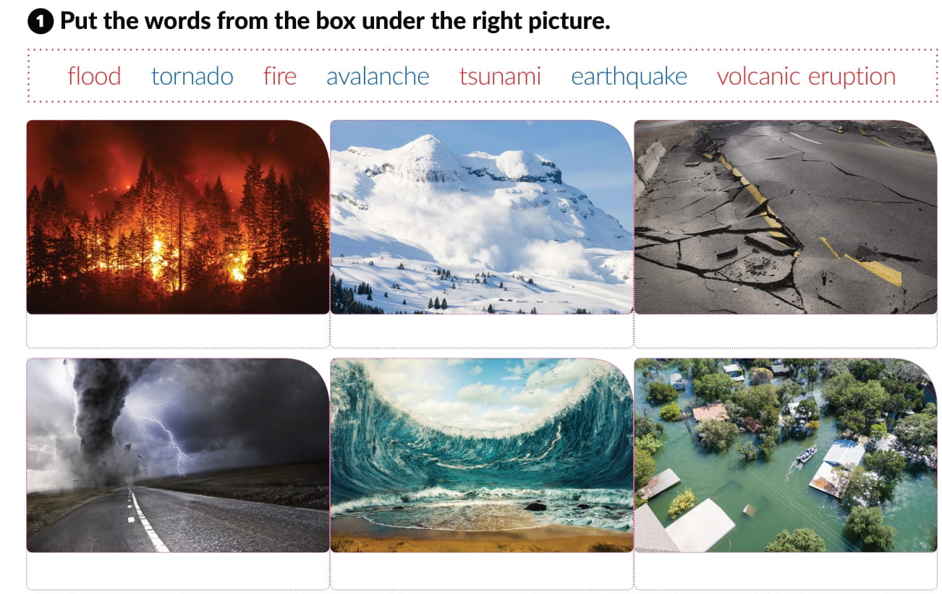
volcanic eruption
fire
avalanche
earthquake
tornado
tsunami
flood

Slide 4
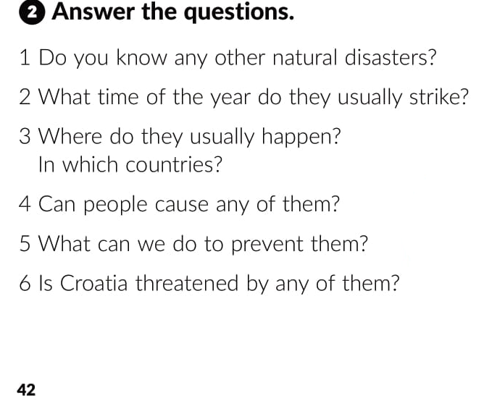
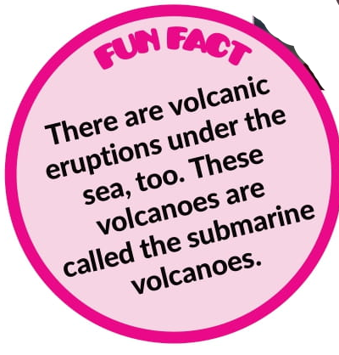

Slide 5
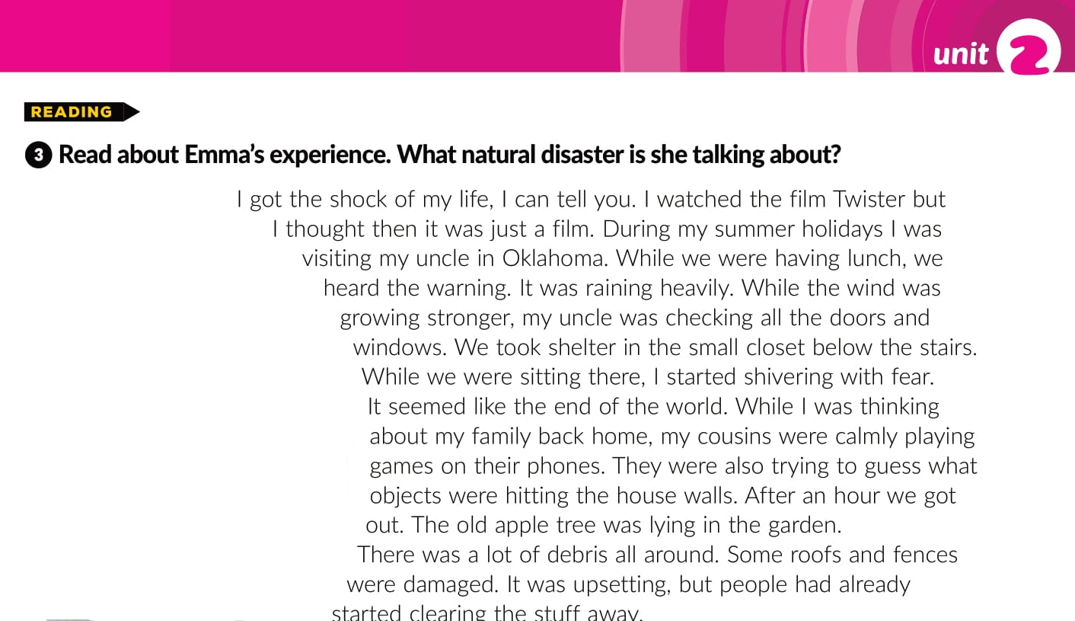

Slide 6
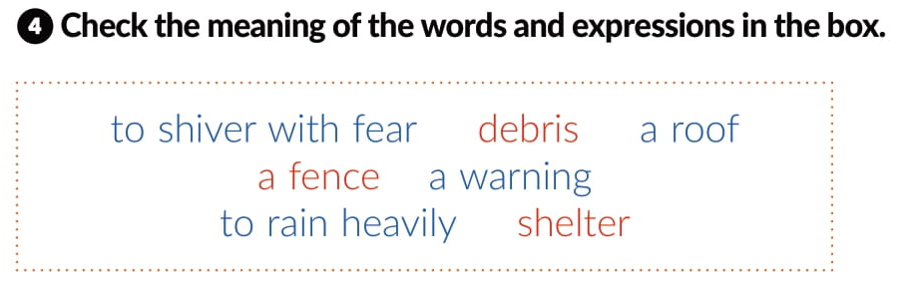
tresti se od straha
krhotine
krov
ograda
upozorenje
jako kišiti
sklonište

Slide 7
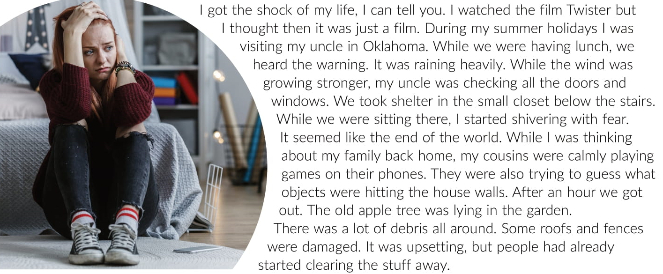
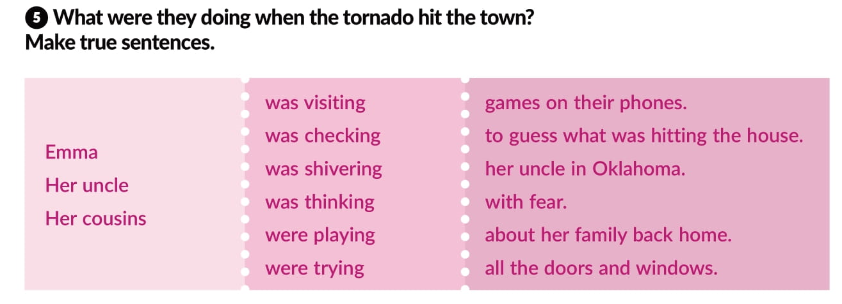

Slide 8
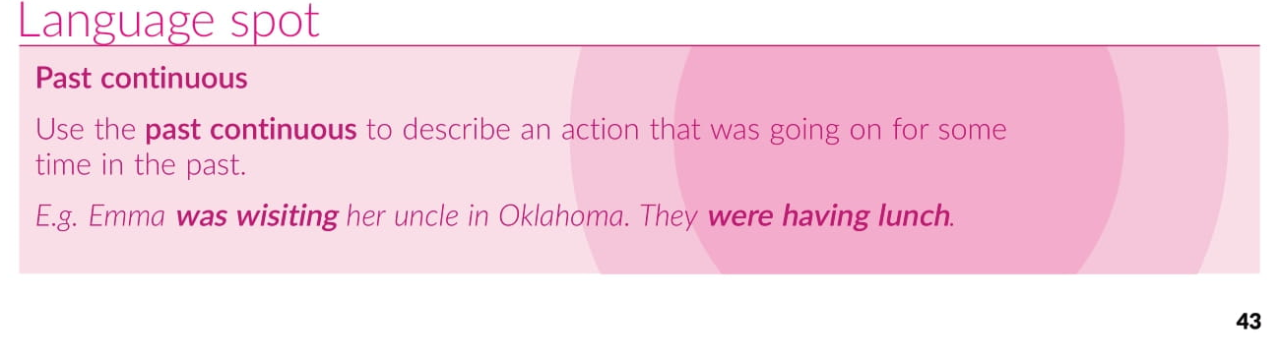

Slide 9
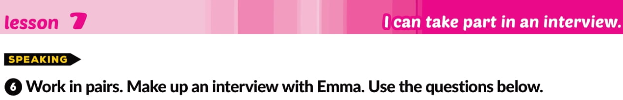
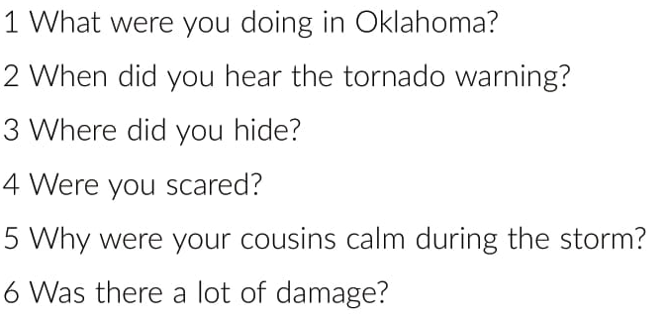

Slide 10
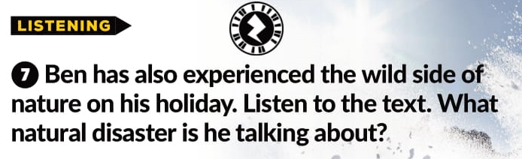
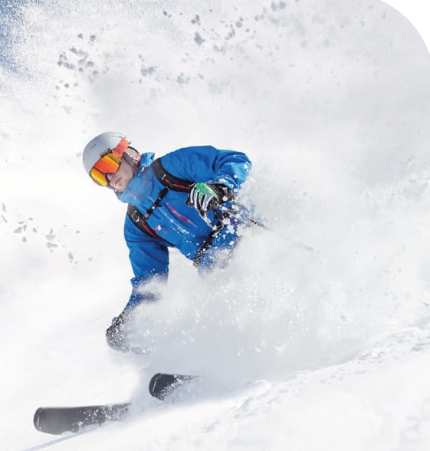
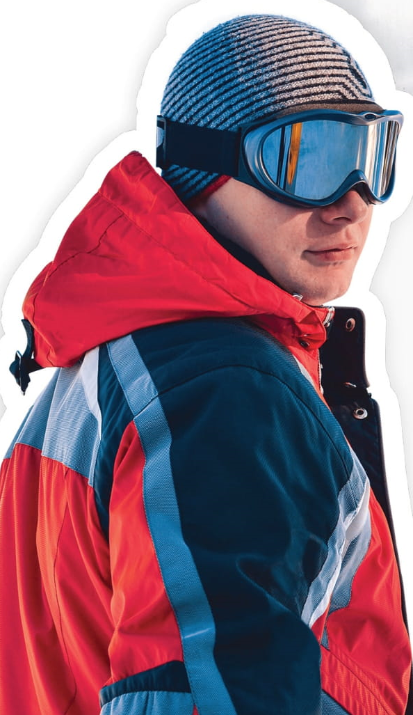

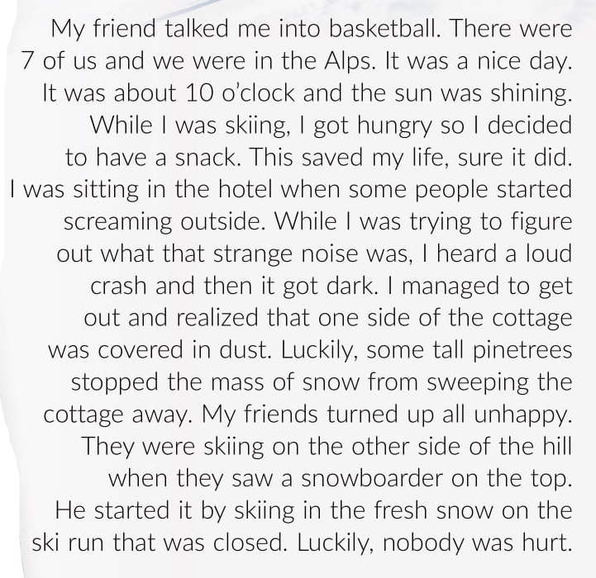
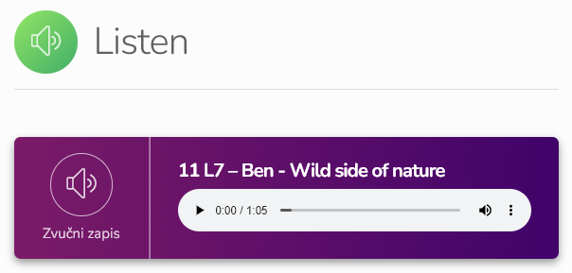
x
skiing
5
x
11
x
x
sandwich
x
cabin
x
snow
x
excited
https://www.e-sfera.hr/dodatni-digitalni-sadrzaji/993a6969-10fc-441e-93e1-655bf7283ea7/

Slide 11
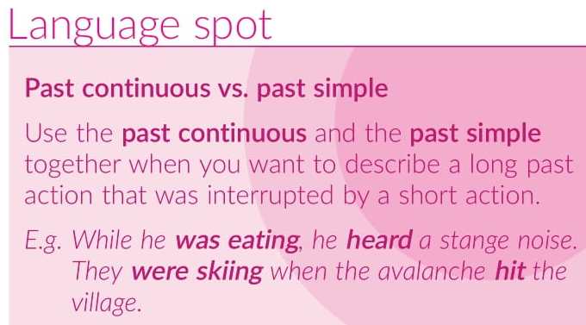
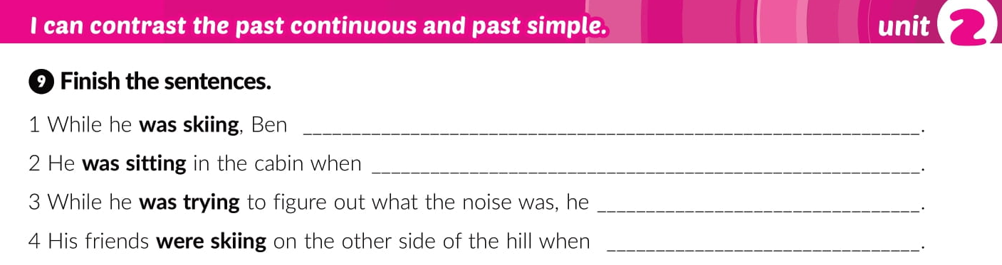
got hungry
some people started screaming outside
heard a loud crash and then it got dark
when they saw a slowboarder on the top

Slide 12


Slide 13
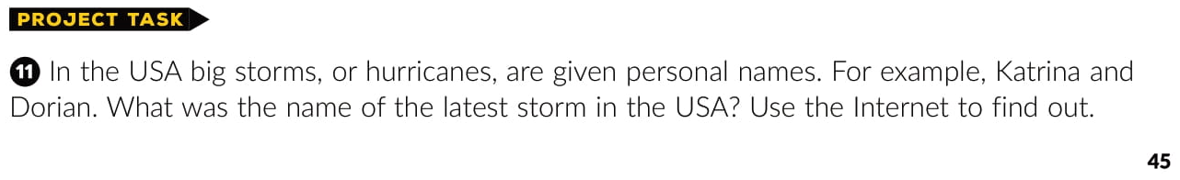
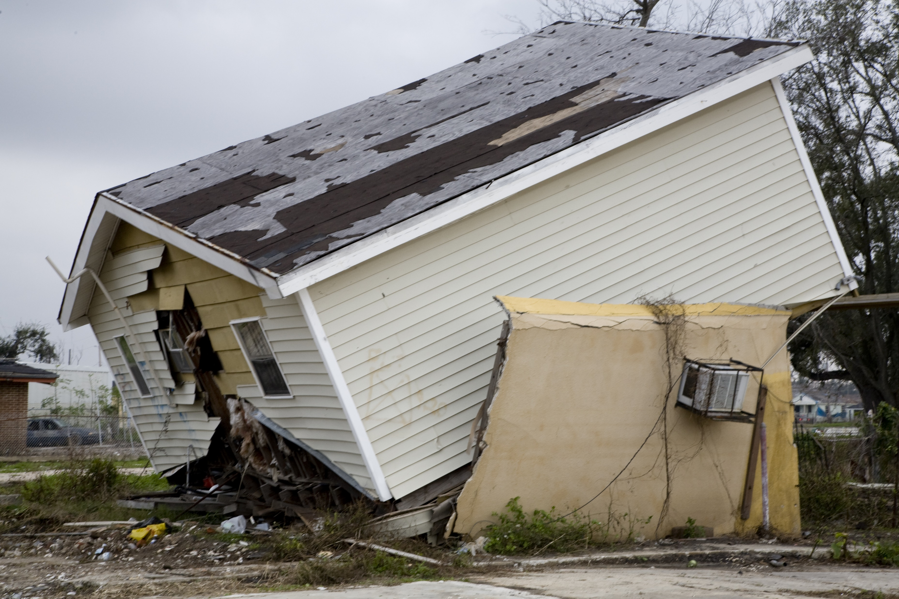
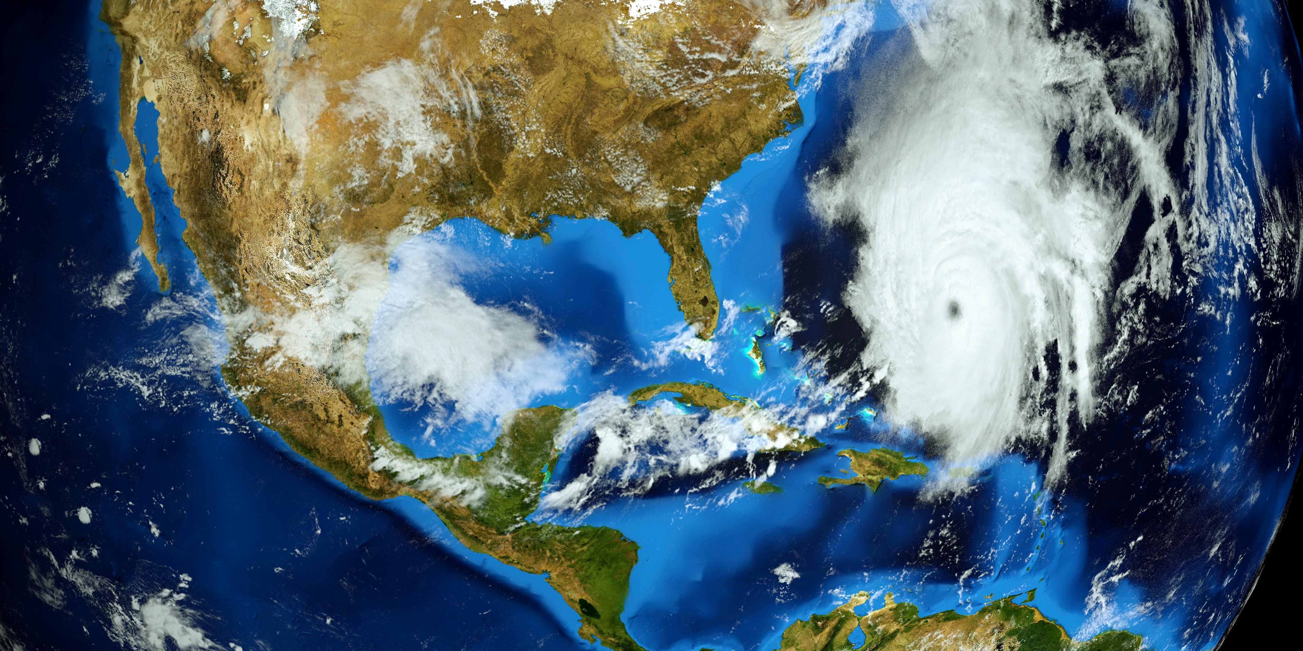

Slide 14
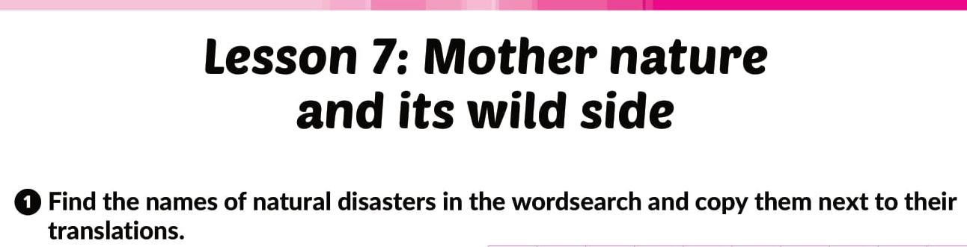
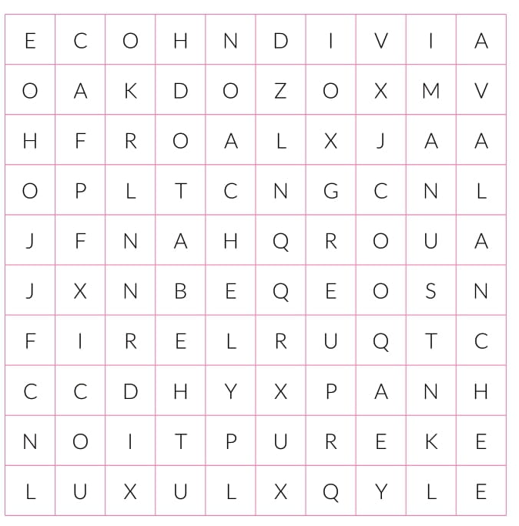
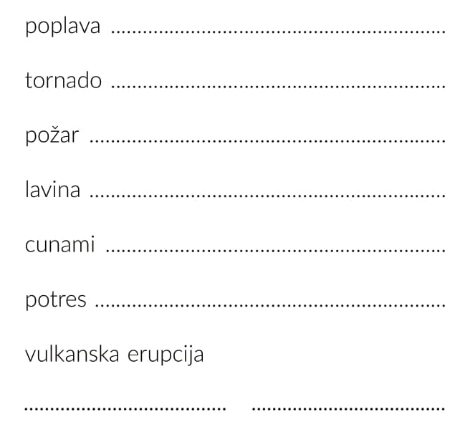
workbook p. 28
flood
tornado
fire
avalanche
tsunami
earthquake
volcanic
eruption

Slide 15
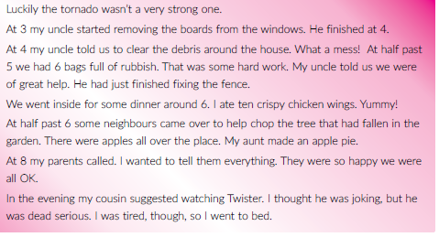
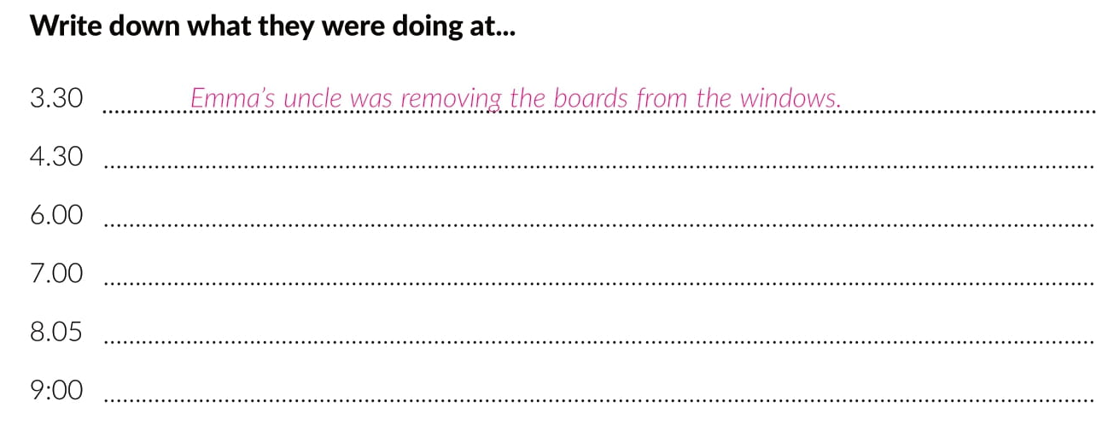
They were clearing the debris around the house.
They were eating dinner.
The neighbours were helping chop the tree. Emma’s aunt was making an apple pie.
Emma was talking to her parents.
Emma’s cousin was watching Twister.

Slide 16
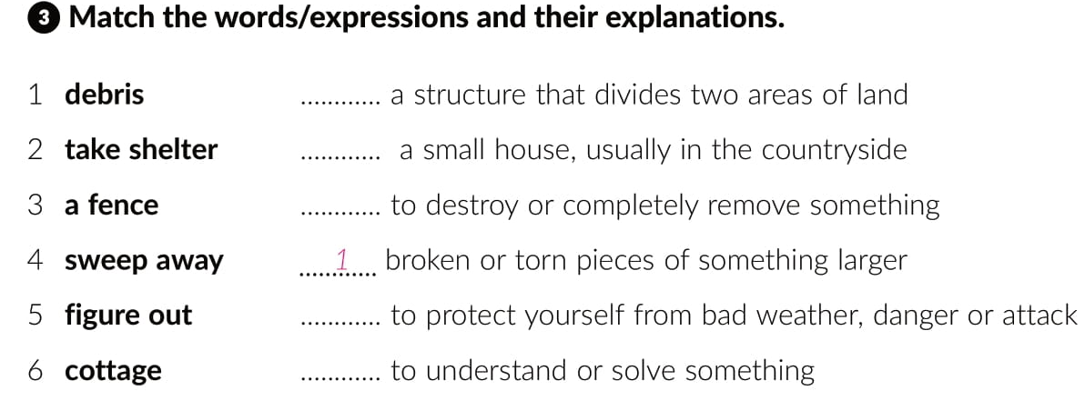
3
6
4
2
5

Slide 17
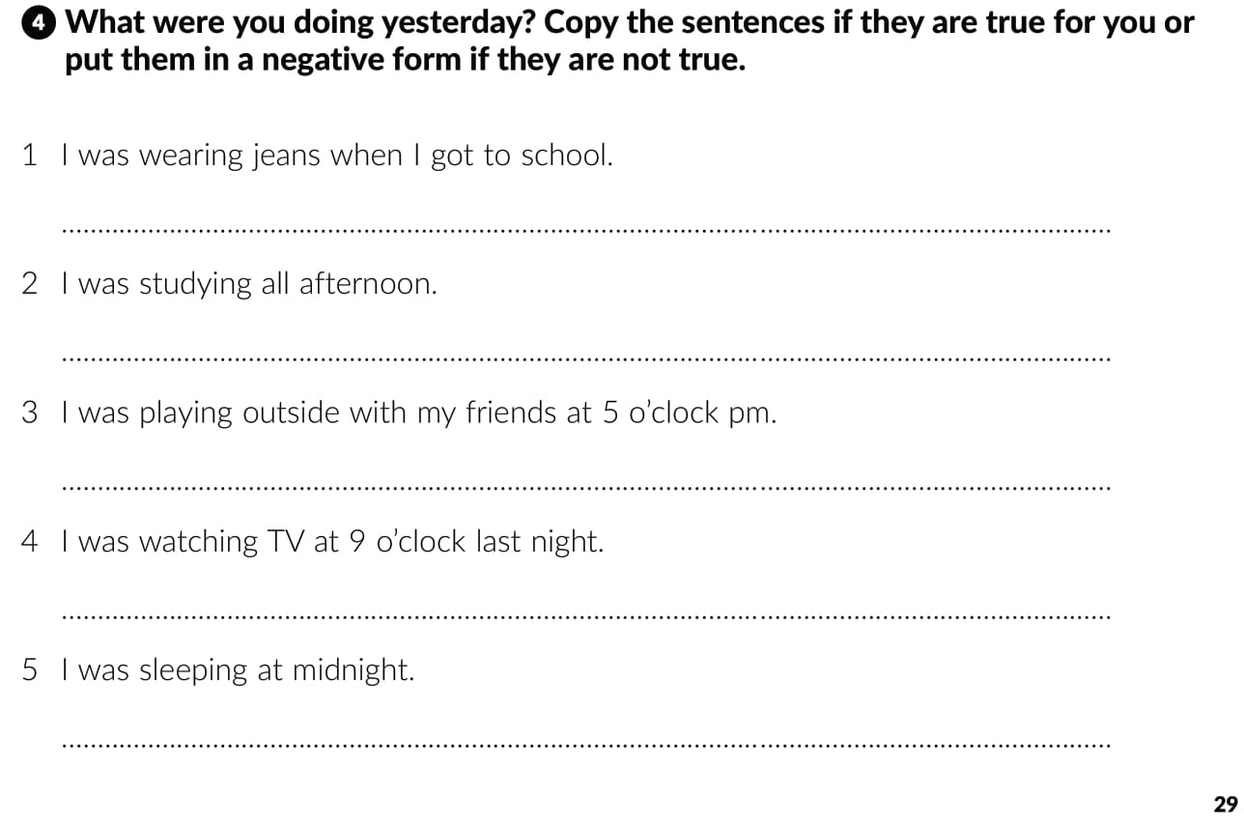
I wasn’t wearing jeans when I got to school.
I wasn’t studying all afternoon.
I wasn’t playing outside with my friends at 5 o’clock pm.
I wasn’t watching TV at 9 o’clock last night.
I wasn’t sleeping at midnight.

Slide 18
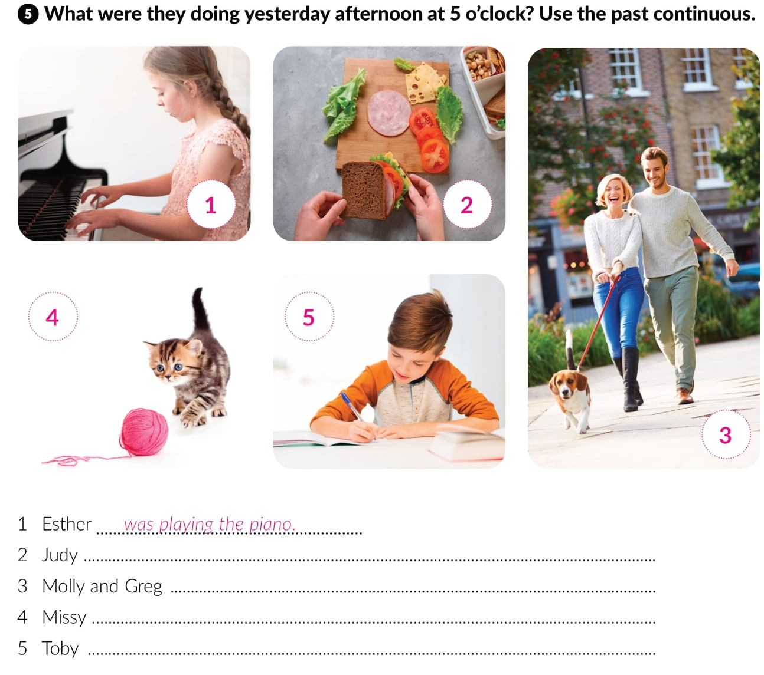
was making a sandwich.
were walking the dog.
was playing with wool ball.
was doing his homework.

Slide 19
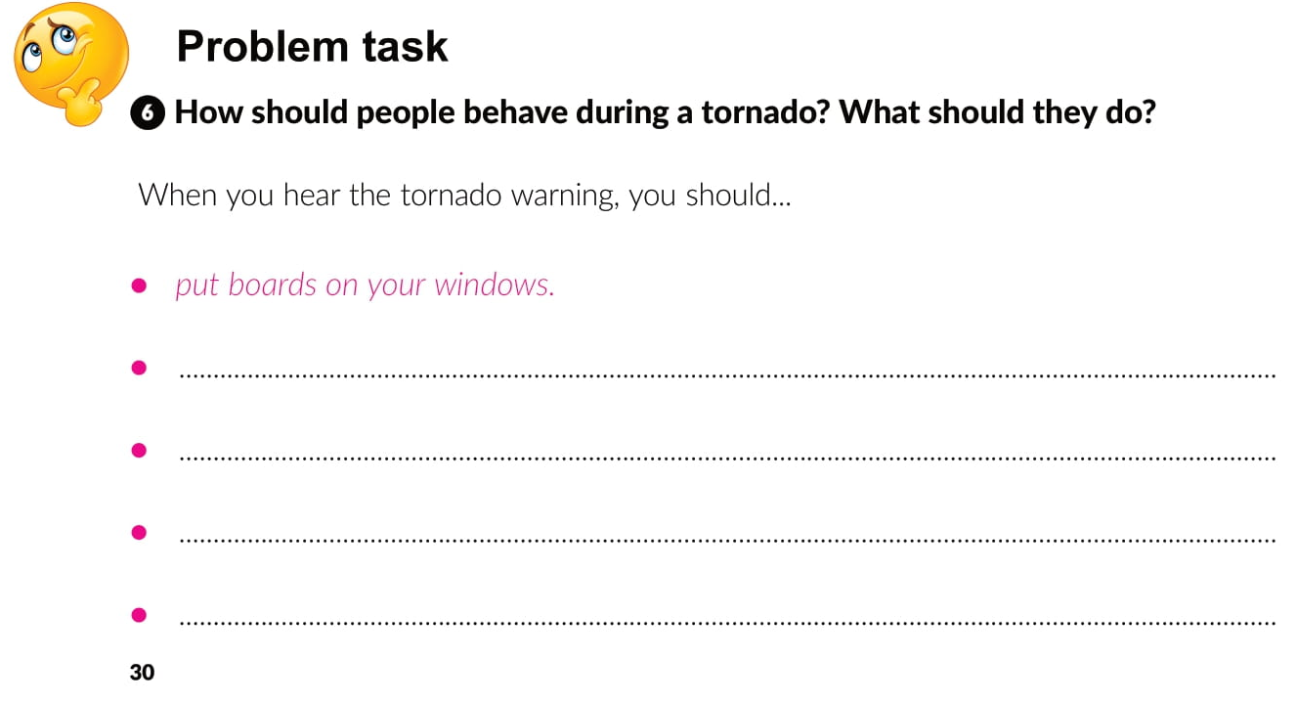

Slide 20

PLAY AND LEARN
https://www.e-sfera.hr/dodatni-digitalni-sadrzaji/993a6969-10fc-441e-93e1-655bf7283ea7/

